Slide 1

Introduction to AWS

Slide 2

Cloud Service Model
Traditional
IaaS
PaaS
SaaS
Applications
Applications
Applications
Applications
Data
Data
Data
Data
Runtime
Runtime
Runtime
Runtime
Middleware
Middleware
Middleware
Middleware
O/S
O/S
O/S
O/S
Virtualization
Virtualization
Virtualization
Virtualization
Servers
Servers
Servers
Servers
Storage
Storage
Storage
Storage
Networking
Networking
Networking
Networking

Slide 3

What is Cloud Computing ?
• Cloud Computing is the on-demand delivery of IT resources & applications via
internet with pay-as-you-go pricing.
• No need to make large up-front investments in hardware
• No need spend a lot of time in managing that hardware
• AWS own and maintain the network-connected hardware
• You provision and use what you need for your workloads

Slide 4
Advantages of Cloud Computing
• Economies of Scale
• Stop Guessing Capacity
• Increase Speed and Agility
• Focus on Business Differentiators
• Go Global in Minutes

Slide 5
Why Should I Learn AWS ?

Slide 6
Why learn AWS?
• Fastest growing cloud computing platform on the planet
• Largest public cloud computing platform on the planet
• More and more organizations are outsourcing their IT to AWS
• AWS Certifications are the most popular IT certification right now
• Top paid IT Certification according to Forbes

Slide 7
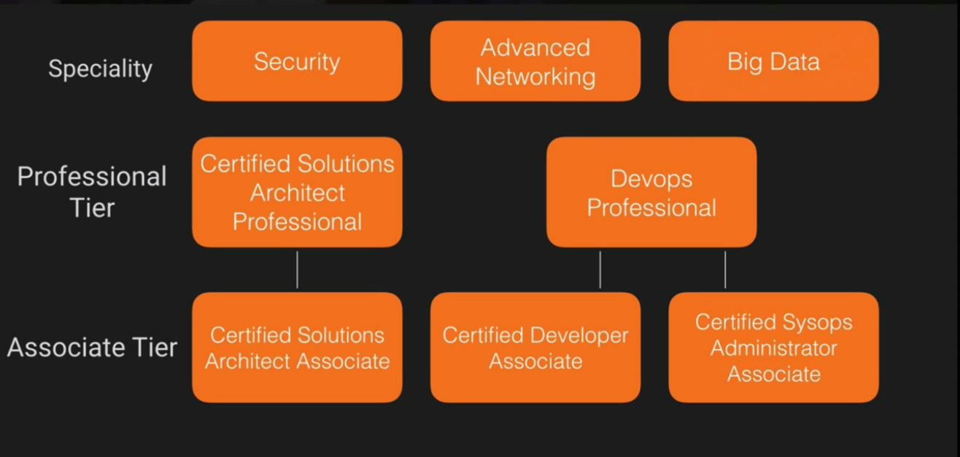
Certification

Slide 8
Pre-requisite for hands on….
• An AWS Free Tier Account (https://aws.amazon.com/free)
• A computer with an SSH Terminal
• A domain name (optional)
• PC Users Need to download Putty and Putty Keygen

Slide 9
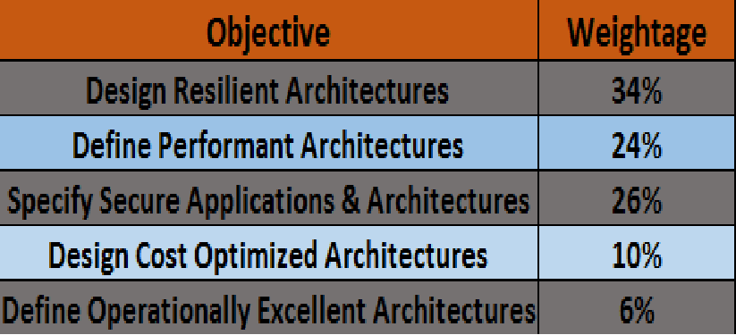
5 Pillars and Exam Blue Print

Slide 10
Time Line of AWS
• AWS was officially launched 2006
• In 2010 all of amazon.com moved to AWS
• In 2012 First Re-Invent Conference hosted
• In 2013 Certifications were launched
• In 2016 Cisco, Dell, EMC, IBM, HPE, Oracle and VMWare generated $206 Billion,
a $15 Billion reduction from 2012 (3% shrinkage every year)

Slide 11
AWS Global Infrastructure
•
•
•
•
AWS provides Infrastructure services on a global scale
AWS sub divides the world into region
A region is a completely independent physical location
Such as
Region: ap-northeast-1
Region: us-west-2
AZ a
AZ b
AZ c
AZ a
AZ b
•
Each AZ is completely independent data center, connected thru low latency, high speed
network links
• Apart from Regions and AZ’s, AWS has Edge Locations around the world for CDN
•
AWS is 100% responsible for the security controls of these layers

Slide 12
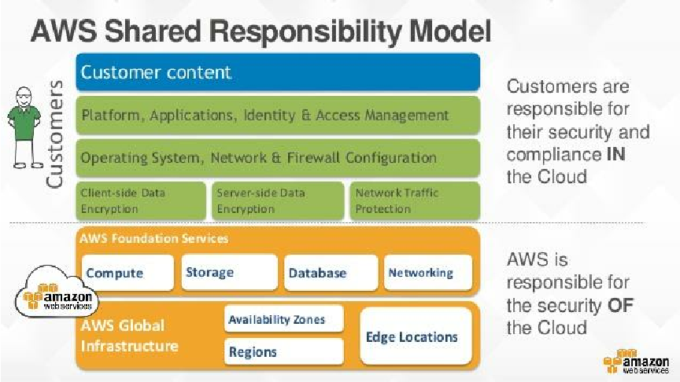
Security

Slide 13
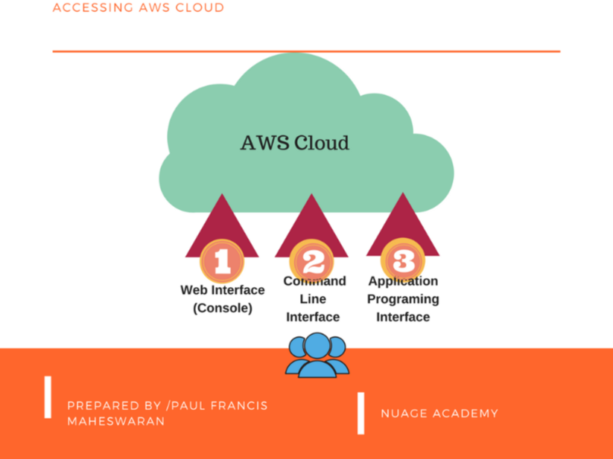

Slide 14
end

